Slide 1

Artificial Intelligence
Expert Systems
CS-632
Dr. Muhammad Aqib
University Institute of Information Technology
PMAS-Arid Agriculture University Rawalpindi

Slide 2
Expert Systems
Expert Systems (ES) are a popular and useful application area in AI.
Having studied KRR, it is instructive to study ES to see a practical manifestation of the principles learnt there.

Slide 3
What is an Expert?
Before we attempt to define an expert system, we have to look at what we mean by the term ‘expert’ when we refer to human experts. Some traits that characterize experts are:
They possess specialized knowledge in a certain area
They possess experience in the given area
They can provide, upon elicitation, an explanation of their decisions
They have a skill set that enables them to translate the specialized knowledge gained through experience into solutions.

Slide 4
What is an Expert?
Try to think of the various traits you associate with experts you might know, e.g. skin specialist, heart specialist, car mechanic, architect, software designer.
You will see that the underlying common factors are similar to those outlined above.

Slide 5
What is an expert system?
According to Durkin, an expert system is “A computer program designed to model the problem solving ability of a human expert”.
With the above discussion of experts in mind, the aspects of human experts that expert systems model are:
Knowledge
Reasoning

Slide 6
History and Evolution
After the so-called dark ages in AI, expert systems were at the forefront of rebirth of AI.
There was a realization in the late 60’s that the general framework of problem solving was not enough to solve all kinds of problem.
Specialized knowledge is a very important component of practical systems.

Slide 7
History and Evolution
People observed that systems that were designed for well-focused problems and domains out-performed more ‘general’ systems.
These observations provided the motivation for expert systems.

Slide 8
Dendral (1960’s)
Dendral was one of the pioneering expert systems.
It was developed at Stanford for NASA to perform chemical analysis of Martian soil for space missions.
Given mass spectral data, the problem was to determine molecular structure.
In the laboratory, the ‘generate and test’ method was used; possible hypothesis about molecular structures were generated and tested by matching to actual data.

Slide 9
Dendral (1960’s)
As human Experts use certain heuristics to rule out certain options when looking at possible structures.
It seemed like a good idea to encode that knowledge in a software system.
The result was the program Dendral, which gained a lot of acclaim and most importantly provided the important distinction that Durkin describes as: ‘Intelligent behavior is dependent, not so much on the methods of reasoning, but on the knowledge, one has to reason with’.

Slide 10
MYCIN (mid 70s)
MYCIN was developed at Stanford to aid physicians in diagnosing and treating patients with a particular blood disease.
The motivation for building MYCIN was that there were few experts of that disease, they also had availability constraints.
Immediate expertise was often needed because they were dealing with a life-threatening condition.
MYCIN was tested in 1982. Its diagnosis on ten selected cases was obtained, along with the diagnosis of a panel of human experts.

Slide 11
MYCIN (mid 70s)
MYCIN compositely scored higher than human experts!
MYCIN was an important system in the history of AI because it demonstrated that expert systems could be used for solving practical problems.
It was pioneering work on the structure of ES (separate knowledge and control), as opposed to Dendral, MYCIN used the same structure that is now formalized for expert systems

Slide 12
R1/XCON (late 70’s)
R1/XCON is also amongst the most cited expert systems.
It was developed by DEC (Digital Equipment Corporation), as a computer configuration assistant.
It was one of the most successful expert systems in routine use, bringing an estimated saving of $25million per year to DEC.
It is a classical example of how an ES can increase productivity of organization, by assisting existing experts.

Slide 13
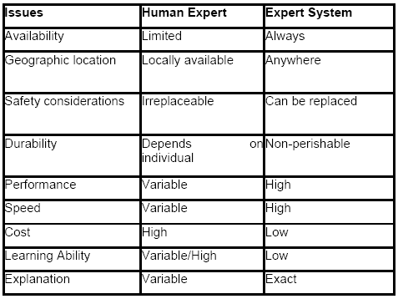
Comparison of a human expert and an expert system
The following table compares human experts to expert systems.e.g. doctor, weather expert.

Slide 14
Roles of an expert system
An expert system may take two main roles, relative to the human expert. It may replace the expert or assist the expert.
Replacement of expert
Consider drastic situations where safety or location is an issue, e.g. a mission to Mars.
In such cases replacement of an expert may be the only feasible option. Also, in cases where an expert cannot be available at a particular geographical location e.g. volcanic areas, it is expedient to use an expert system as a substitute.
An example of this role is a France based oil exploration company that maintains a number of oil wells. They had a problem that the drills would occasionally become stuck.
Often, delays due to this problem cause huge losses until an expert can arrive at the scene to investigate. The company decided to deploy an expert system to solve the problem. A system called ‘Drilling Advisor’ (Elf-Aquitane 1983) was developed, which saved the company from huge losses that would be incurred otherwise.

Slide 15
Roles of an expert system
Assisting expert
Assisting an expert is the most commonly found role of an ES. The goal is to aid an expert in a routine tasks to increase productivity, or to aid in managing a complex situation by using an expert system that may itself draw on experience of other (possibly more than one) individuals.
Such an expert system helps an expert overcome shortcomings such as recalling relevant information. XCON is an example of how an ES can assist an expert.

Slide 16
How are expert systems used?
Expert systems may be used in a host of application areas including
diagnosis, interpretation, prescription, design, planning, control, instruction, prediction and simulation.

Slide 17
Control applications
In control applications, ES are used to adaptively govern/regulate the behavior of a system, e.g. controlling a manufacturing process, or medical treatment.
The ES obtains data about current system state, reasons, predicts future system states and recommends (or executes) adjustments accordingly. An example of such a system is VM (Fagan 1978).
This ES is used to monitor patient status in the intensive care unit.
It analyses heart rate, blood pressure and breathing measurements to adjust the ventilator being used by the patient.

Slide 18
Design
ES are used for design applications to configure objects under given design constraints, e.g. XCON.
Such ES often use non-monotonic reasoning, because of implications of steps on previous steps.
Another example of a design ES is PEACE (Dincbas 1980), which is a CAD tool to assist in design of electronic structures.

Slide 19
Diagnosis and Prescription
An ES can serve to identify system malfunction points.
To do this it must have knowledge of possible faults as well as diagnosis methodology extracted from technical experts, e.g. diagnosis based on patient’s symptoms, diagnosing malfunctioning electronic structures.
Most diagnosis ES have a prescription subsystem. Such systems are usually interactive, building on user information to narrow down diagnosis.

Slide 20
Instruction and Simulation
ES may be used to guide the instruction of a student in some topic.
Tutoring applications include GUIDON (Clancey 1979), which instructs students in diagnosis of bacterial infections.
Its strategy is to present user with cases (of which it has solution).
It then analyzes the student’s response.
It compares the students approach to its own and directs student based on differences.

Slide 21
Simulation
ES can be used to model processes or systems for operational study, or for use along with tutoring applications
Interpretation
According to Durkin, interpretation is ‘Producing an understanding of situation from given information’. An example of a system that provides interpretation is FXAA (1988).
This ES provides financial assistance for a commercial bank. It looks at a large number of transactions and identifies irregularities in transaction trends. It also enables automated audit.

Slide 22
Planning and prediction
ES may be used for planning applications, e.g. recommending steps for a robot to carry out certain steps, cash management planning.
SMARTPlan is such a system, a strategic market planning expert (Beeral, 1993).
It suggests appropriate marketing strategy required to achieve economic success.
Similarly, prediction systems infer likely consequences from a given situation.

Slide 23
Appropriate domains for expert systems
When analyzing a particular domain to see if an expert system may be useful, the system analyst should ask the following questions:
Can the problem be effectively solved by conventional programming? If not, an ES may be the choice, because ES are especially suited to ill-structured problems.
Is the domain well-bounded? e.g. a headache diagnosis system may eventually have to contain domain knowledge of many areas of medicine because it is not easy to limit diagnosis to one area. In such cases where the domain is too wide, building an ES may be not be a feasible proposition.
What are the practical issues involved? Is some human expert willing to cooperate? Is the expert’s knowledge especially uncertain and heuristic? If so, ES may be useful.

Slide 24
Expert system structure
Having discussed the scenarios and applications in which expert systems may be useful, let us delve into the structure of expert systems.
To facilitate this, we use the analogy of an expert (say a doctor) solving a problem. The expert has the following:
Focused area of expertise
Specialized Knowledge (Long-term Memory, LTM)
Case facts (Short-term Memory, STM)
Reasons with these to form new knowledge
Solves the given problem

Slide 25
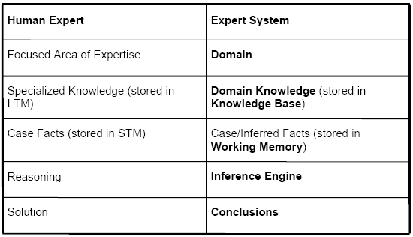
Expert system structure

Slide 26
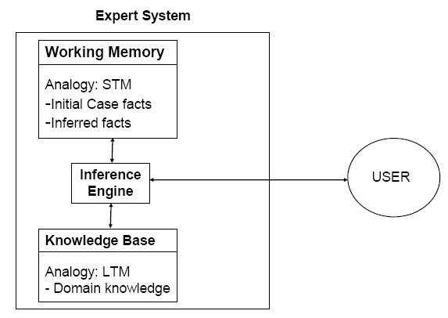
Expert system structure

Slide 27
Knowledge Base
The knowledge base is the part of an expert system that contains the domain knowledge, i.e.
Problem facts, rules
Concepts
Relationships
The power of an ES lies to a large extent in its richness of knowledge. Therefore, one of the prime roles of the expert system designer is to act as a knowledge engineer.
As a knowledge engineer, the designer must overcome the knowledge acquisition bottleneck and find an effective way to get information from the expert and encode it in the knowledge base, using one of the knowledge representation techniques
One way of encoding that knowledge is in the form of IF-THEN rules.

Slide 28
Working memory
The working memory is the ‘part of the expert system that contains the problem facts that are discovered during the session’ according to Durkin.
One session in the working memory corresponds to one consultation. During a consultation:
User presents some facts about the situation.
These are stored in the working memory.
Using these and the knowledge stored in the knowledge base, new information is inferred and also added to the working memory.

Slide 29
Inference Engine
The inference engine can be viewed as the processor in an expert system that matches the facts contained in the working memory with the domain knowledge contained in the knowledge base, to draw conclusions about the problem.
It works with the knowledge base and the working memory, and draws on both to add new facts to the working memory.
If the knowledge of an ES is represented in the form of IF-THEN rules, the Inference Engine has the following strategy: Match given facts in working memory to the premises of the rules in the knowledge base, if match found, ‘fire’ the conclusion of the rule, i.e. add the conclusion to the working memory.
Do this repeatedly, while new facts can be added, until you come up with the desired conclusion.

Slide 30
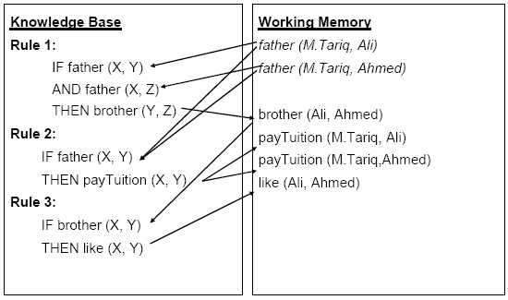
Expert System Example: Family

Slide 31
How it Works?
Let’s look at the example above to see how the knowledge base and working memory are used by the inference engine to add new facts to the working memory.
The knowledge base column on the left contains the three rules of the system.
The working memory starts out with two initial case facts:
father (M.Tariq, Ali)
father (M.Tariq, Ahmed)
The inference engine matches each rule in turn with the rules in the working memory to see if the premises are all matched.

Slide 32
How it Works?
Once all premises are matched, the rule is fired and the conclusion is added to the working memory, e.g. the premises of rule 1 match the initial facts, therefore it fires and the fact brother(Ali, Ahmed) is fired.
This matching of rule premises and facts continues until no new facts can be added to the system.
The matching and firing is indicated by arrows in the above table.

Slide 33
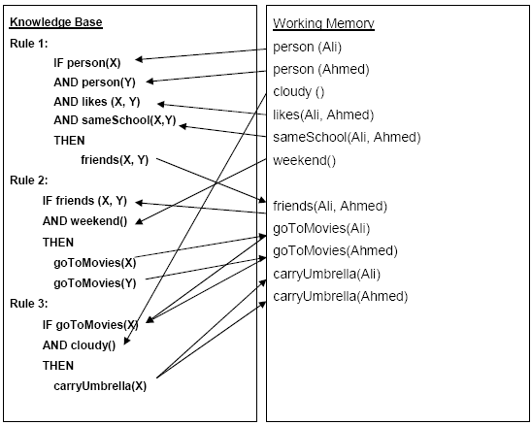
Expert system example: raining

Slide 34
Explanation facility
The explanation facility is a module of an expert system that allows transparency of operation, by providing an explanation of how it reached the conclusion.
In the family example above, how does the expert system draw the conclusion that Ali likes Ahmed?
The answer to this is the sequence of reasoning steps as shown with the arrows in the table below.

Slide 35
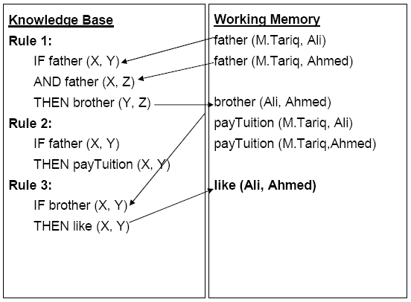
Explanation facility

Slide 36
Characteristics of expert systems
ES have an explanation facility. This is the module of an expert system that allows transparency of operation, by providing an explanation of how the inference engine reached the conclusion. We want ES to have this facility so that users can have knowledge of how it reaches its conclusion.
An expert system is different from conventional programs in the sense that program control and knowledge are separate. We can change one while affecting the other minimally. This separation is manifest in ES structure; knowledge base, working memory and inference engine. Separation of these components allows changes to the knowledge to be independent of changes in control and vice versa.

Slide 37
Characteristics of expert systems
”There is a clear separation of general knowledge about the problem (the rules forming the knowledge base) from information about the current problem (the input data) and methods for applying the general knowledge to a problem (the rule interpreter). The program itself is only an interpreter (or general reasoning mechanism) and ideally the system can be changed simply by adding or subtracting rules in the knowledge base” (Duda)
Besides these properties, an expert system also possesses expert knowledge in that it embodies expertise of human expert.
An expert system, like a human expert makes mistakes, but that is tolerable if we can get the expert system to perform at least as well as the human expert it is trying to emulate.

Slide 38
Programming vs. knowledge engineering
Conventional programming is a sequential, three step process: Design, Code, Debug.
Knowledge engineering, which is the process of building an expert system, also involves assessment, knowledge acquisition, design, testing, documentation and maintenance.
However, there are some key differences between the two programming paradigms.
Conventional programming focuses on solution, while ES programming focuses on problem.

Slide 39
Programming vs. knowledge engineering
An ES is designed on the philosophy that if we have the right knowledge base, the solution will be derived from that data using a generic reasoning mechanism.
Unlike traditional programs, you don’t just program an ES and consider it ‘built’.
It grows as you add new knowledge.
Once framework is made, addition of knowledge dictates growth of ES.

Slide 40
People involved in an expert system project
The main people involved in an ES development project are
the domain expert
knowledge engineer
end user.

Slide 41
People involved in an expert system project
Domain Expert
A domain expert is ‘A person who posses the skill and knowledge to solve a specific problem in a manner superior to others’ (Durkin). For our purposes, an expert should have expert knowledge in the given domain, good communication skills, availability and readiness to co-operate.
Knowledge Engineer
A knowledge engineer is ‘a person who designs, builds and tests an Expert System’ (Durkin). A knowledge engineer plays a key role in identifying, acquiring and encoding knowledge.
End-user
The end users are the people who will use the expert system. Correctness, usability and clarity are important ES features for an end user.

Slide 42
Inference mechanisms
We have two formal inference mechanisms
Forward chaining
Backward chaining.

Slide 43
Forward Chaining
It is an “inference strategy that begins with a set of known facts, derives new facts using rules whose premises match the known facts, and continues this process until a goal sate is reached or until no further rules have premises that match the known or derived facts” (Durkin).
It is a data-driven approach.

Slide 44
Forward Chaining
Add facts to working memory (WM)
Take each rule in turn and check to see if any of its premises match the facts in the WM
When matches found for all premises of a rule, place the conclusion of the rule in WM.
Repeat this process until no more facts can be added. Each repetition of the process is called a pass.

Slide 45
Doctor example (forward chaining)
Rules
Rule 1
IF The patient has deep cough
AND We suspect an infection
THEN The patient has Pneumonia
Rule 2
IF The patient’s temperature is above 100
THEN Patient has fever
Rule 3
IF The patient has been sick for over a fortnight
AND The patient has a fever
THEN We suspect an infection

Slide 46
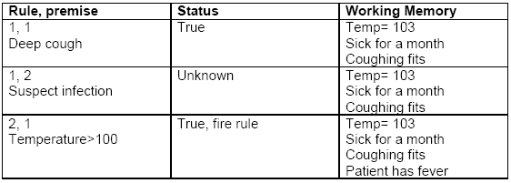
Case facts
Patients temperature= 103
Patient has been sick for over a month
Patient has violent coughing fits
Pass 1

Slide 47
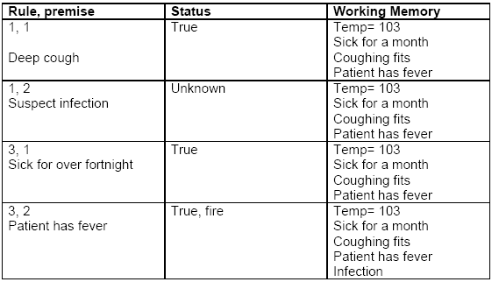
Second Pass

Slide 48
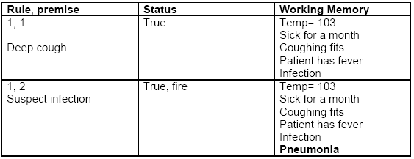
Third Pass

Slide 49
Issues in forward chaining
Undirected search
The forward chaining inference engine infers all possible facts from the given facts.
It has no way of distinguishing between important and unimportant facts.
Therefore, equal time spent on trivial evidence as well as crucial facts.
This is draw back of this approach

Slide 50
Issues in forward chaining
Conflict resolution
This is the question of what to do when the premises of two rules match the given facts. Which should be fired first? If we fire both, they may add conflicting facts, e.g.
IF you are bored
AND you have no cash
THEN go to a friend’s place
IF you are bored
AND you have a credit card
THEN go watch a movie
If both rules are fired, you will add conflicting recommendations to the working memory.

Slide 51
Conflict resolution strategies
To overcome the conflict problem stated above, we may choose to use one of the following conflict resolution strategies:
Fire first rule in sequence (rule ordering in list). Using this strategy all the rules in the list are ordered (the ordering imposes prioritization). When more than one rule matches, we simply fire the first in the sequence
Assign rule priorities (rule ordering by importance). Using this approach we assign explicit priorities to rules to allow conflict resolution

Slide 52
Conflict resolution strategies
More specific rules (more premises) are preferred over general rules. This strategy is based on the observation that a rule with more premises, in a sense, more evidence or votes from its premises, therefore it should be fired in preference to a rule that has less premises.
Prefer rules whose premises were added more recently to WM (time stamping). This allows prioritizing recently added facts over older facts.
Parallel Strategy (view-points). Using this strategy, we do not actually resolve the conflict by selecting one rule to fire. Instead, we branch out our execution into a tree, with each branch operation in parallel on multiple threads of reasoning. This allows us to maintain multiple view-points on the argument concurrently

Slide 53
Backward chaining
Backward chaining is an inference strategy that works backward from a hypothesis to a proof.
You begin with a hypothesis about what the situation might be. Then you prove it using given facts, e.g. a doctor may suspect some disease and proceed by inspection of symptoms.
In backward chaining terminology, the hypothesis to prove is called the goal.

Slide 54
Backward chaining
Start with the goal.
Goal may be in WM initially, so check and you are done if found!
If not, then search for goal in the THEN part of the rules (match conclusions, rather than premises). This type of rule is called goal rule.
Check to see if the goal rule’s premises are listed in the working memory.
Premises not listed become sub-goals to prove.
Process continues in a recursive fashion until a premise is found that is not supported by a rule, i.e. a premise is called a primitive, if it cannot be concluded by any rule
When a primitive is found, ask user for information about it. Back track and use this information to prove sub-goals and subsequently the goal.

Slide 55
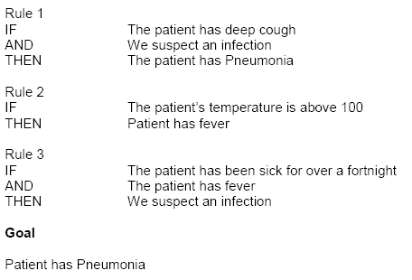
Backward chaining Example

Slide 56
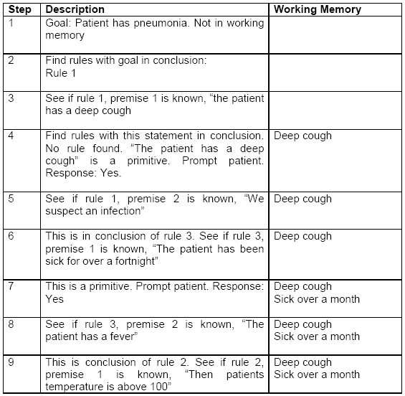

Slide 57
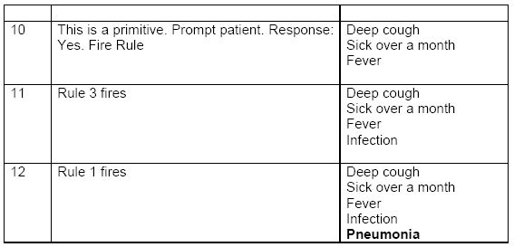

Slide 58
Design of expert systems
The general stages of the expert system development lifecycle or ESDLC are
Feasibility study
Rapid prototyping
Alpha system (in-house verification)
Beta system (tested by users)
Maintenance and evolution

Slide 59
Linear model
The main phases of the linear sequence are
Planning
Knowledge acquisition and analysis
Knowledge design Code
Knowledge verification
System evaluation

Slide 60
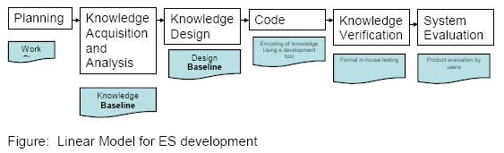
Linear model

Slide 61
Thank You

